Slide 1
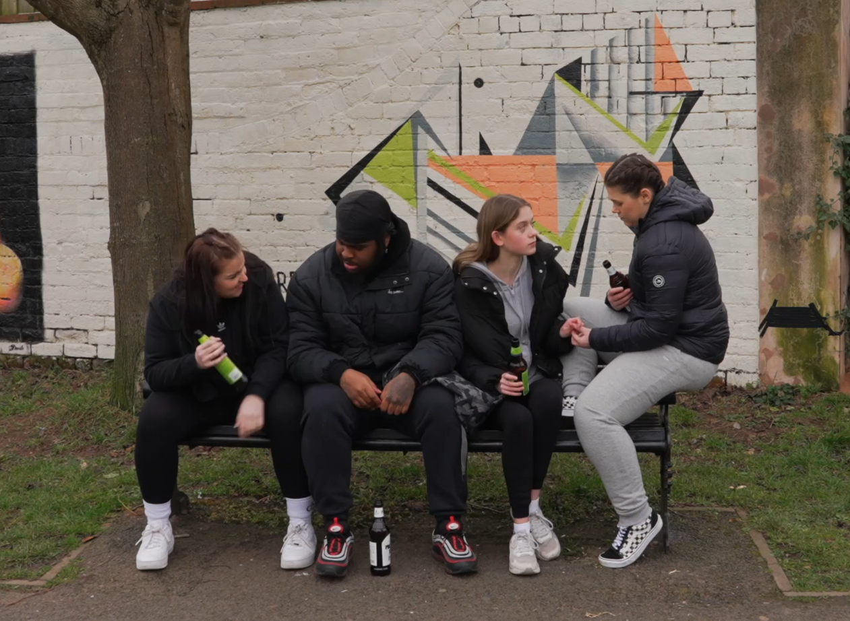
1
Notes:
Alcohol

Slide 2
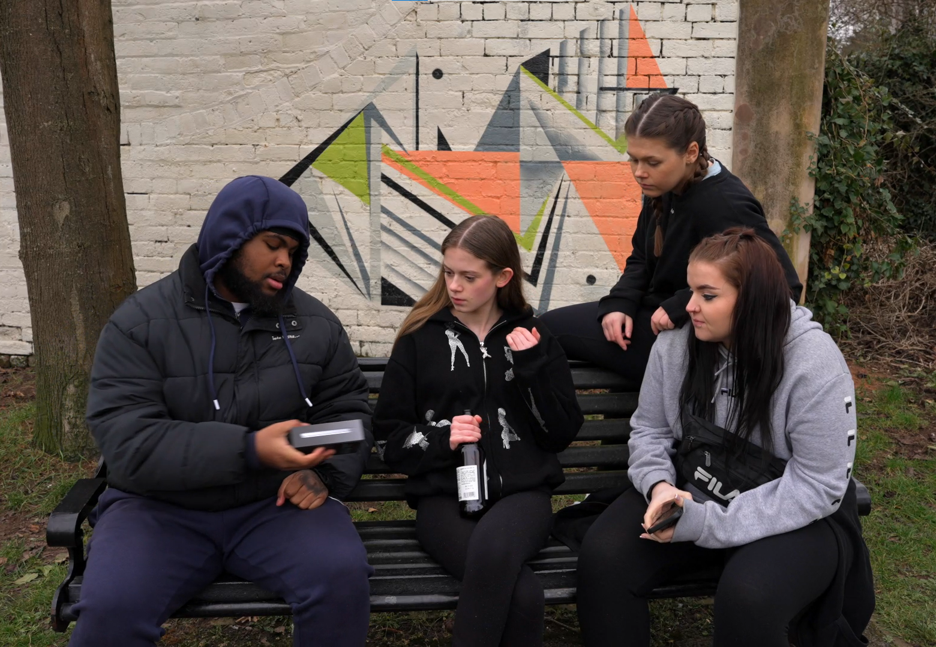
2
Notes:
presents

Slide 3
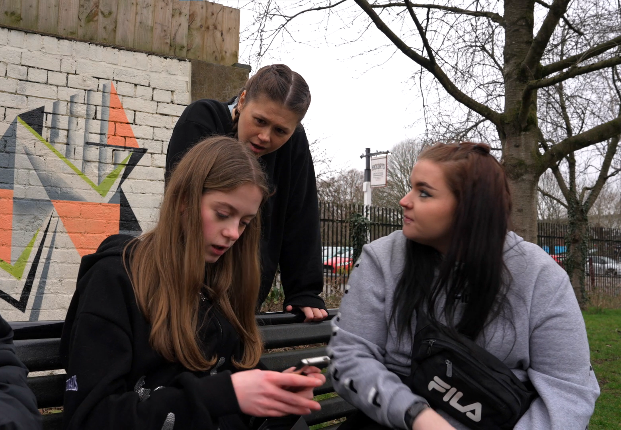
3
Notes:
controlling

Slide 4
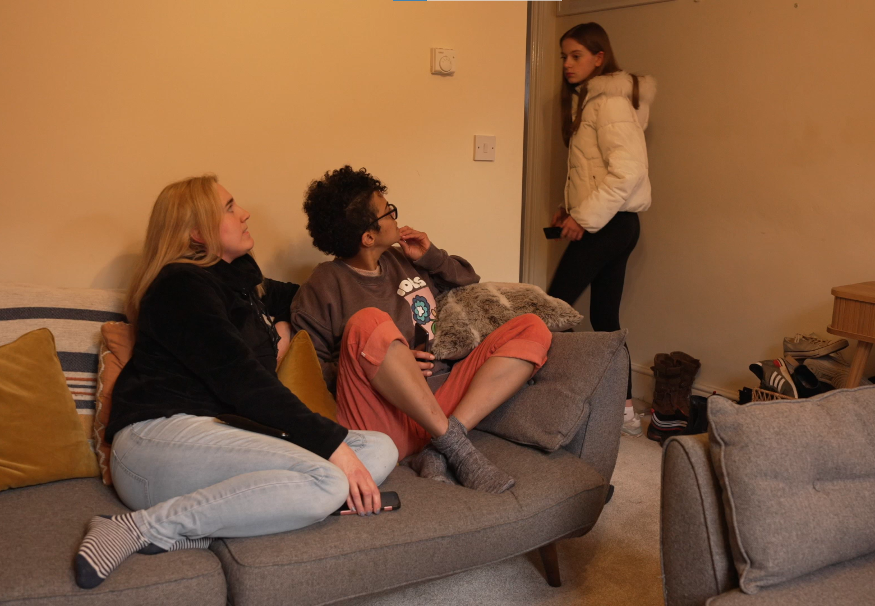
4
Notes:
Staying out late

Slide 5
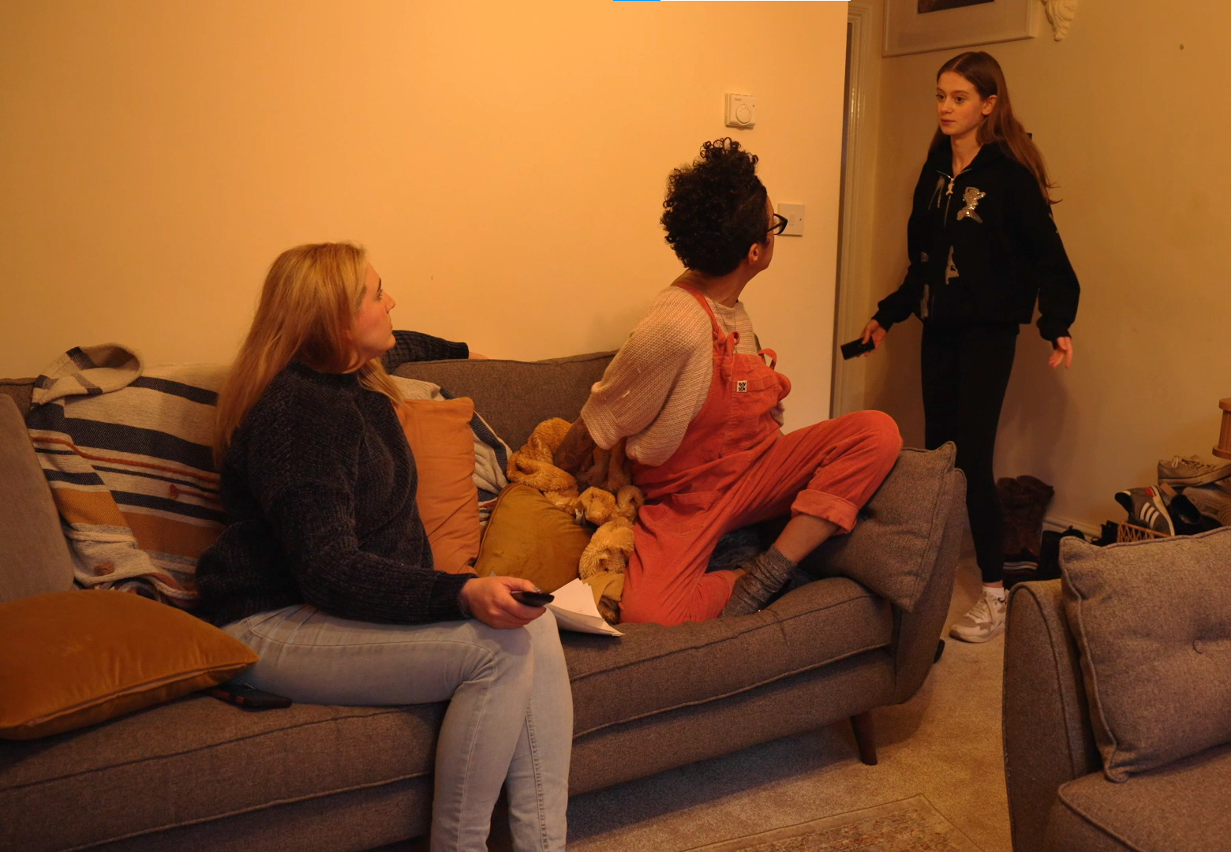
5
Notes:
Distancing from family and friends

Slide 6
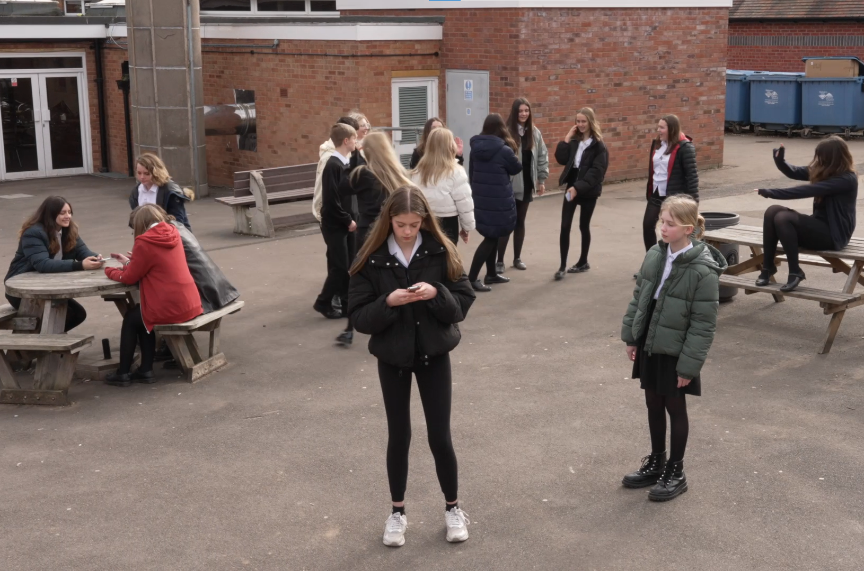
6
Notes:
Distancing from family and friends

Slide 7
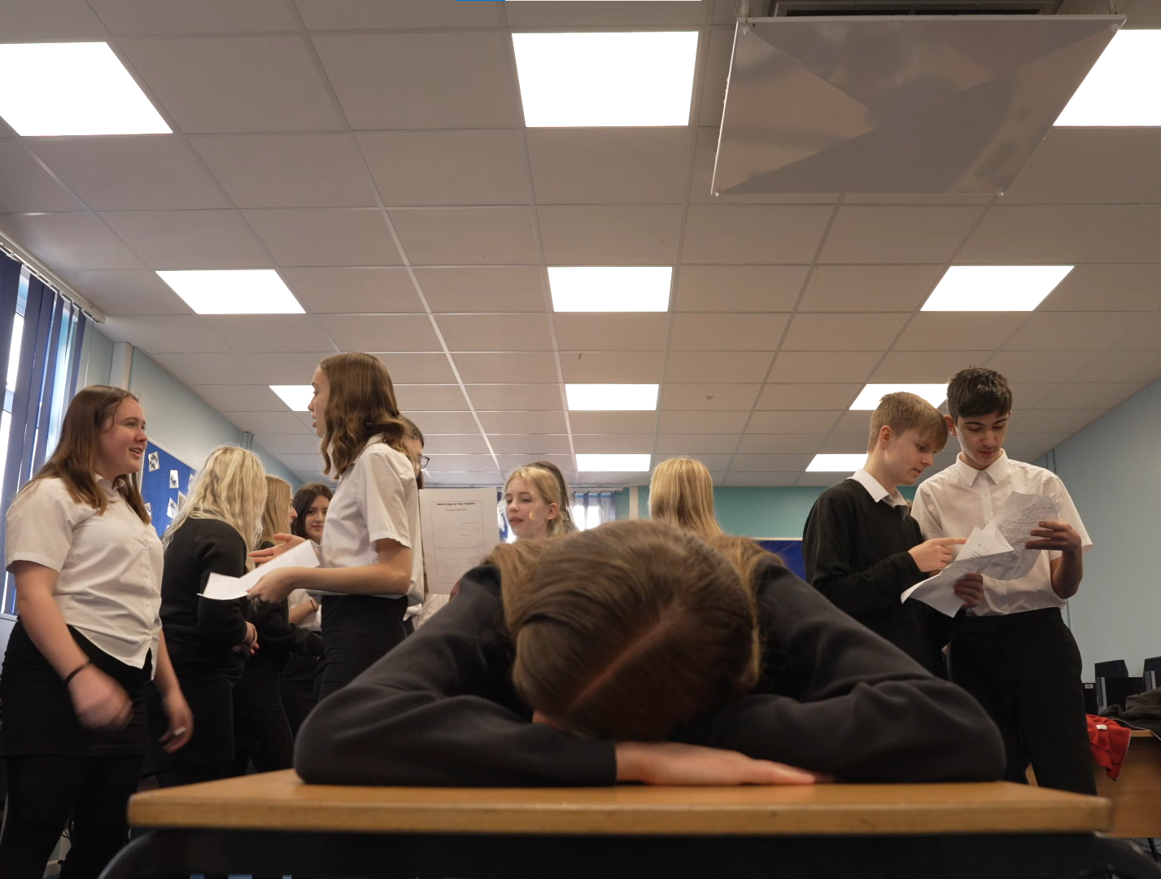
7
Notes:
Tired and losing interest in doing well at school

Slide 8
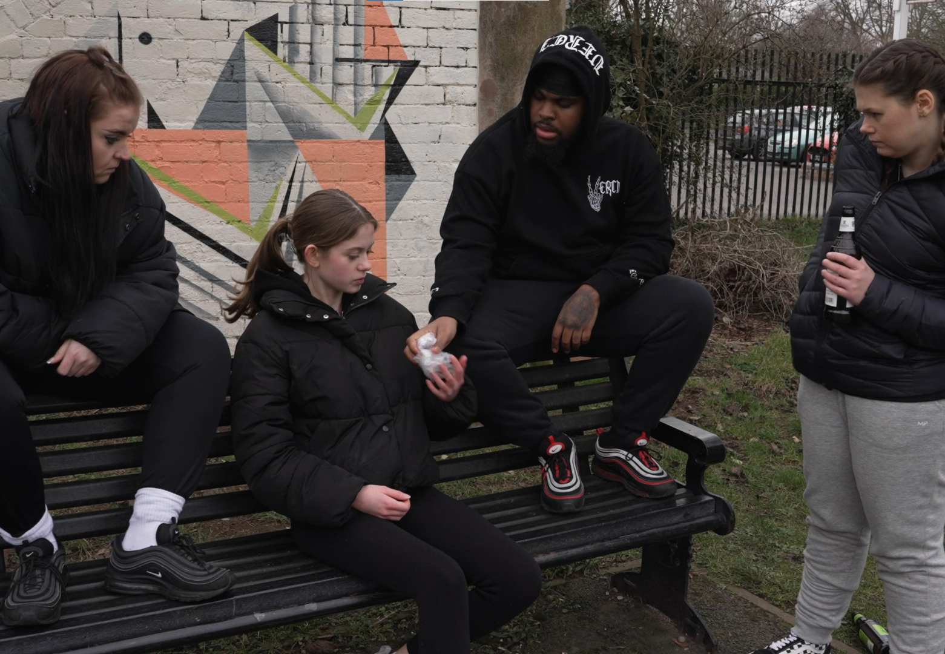
8
Notes:
No choice - “I’m not asking”

Slide 9
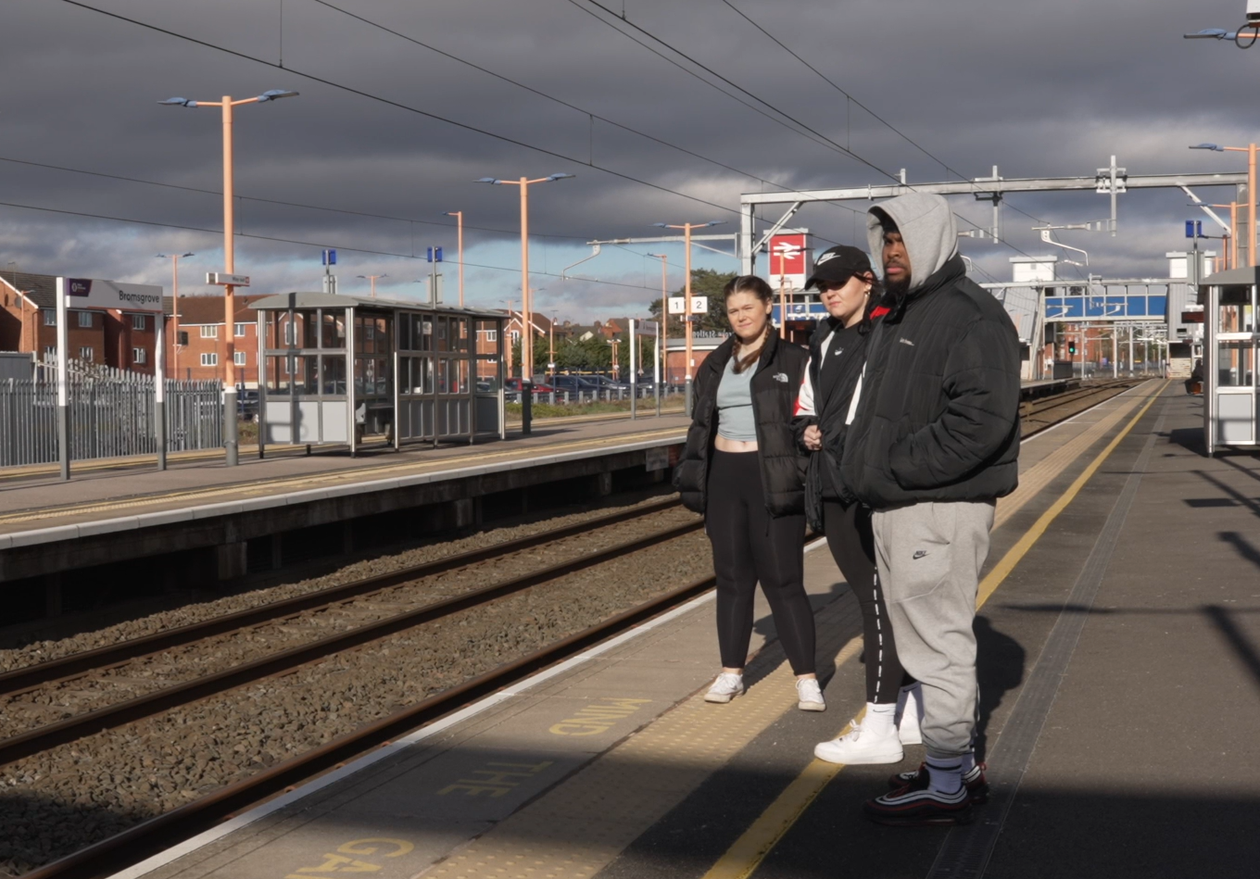
9
Notes:
Yellow line – risky behaviour

