Slide 1
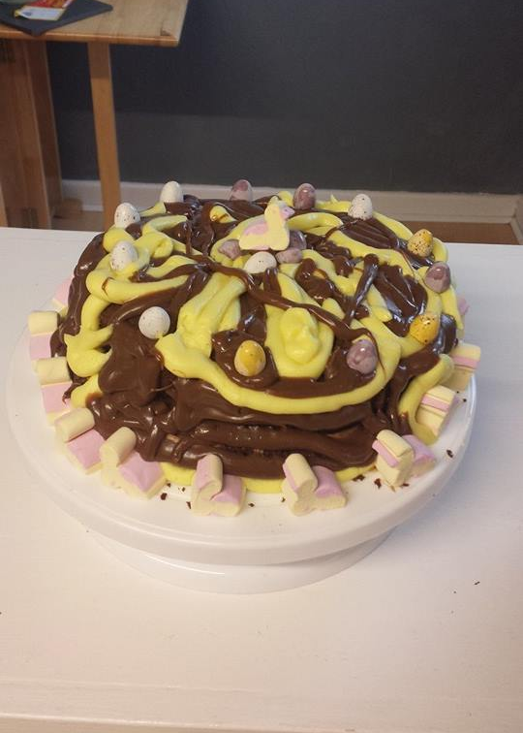
Expectation
Reality

Slide 2
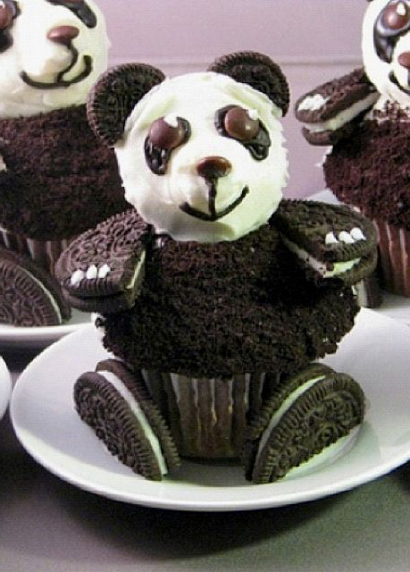
Expectation
Reality

Slide 3
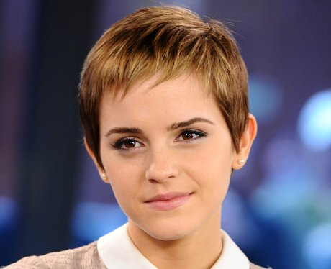
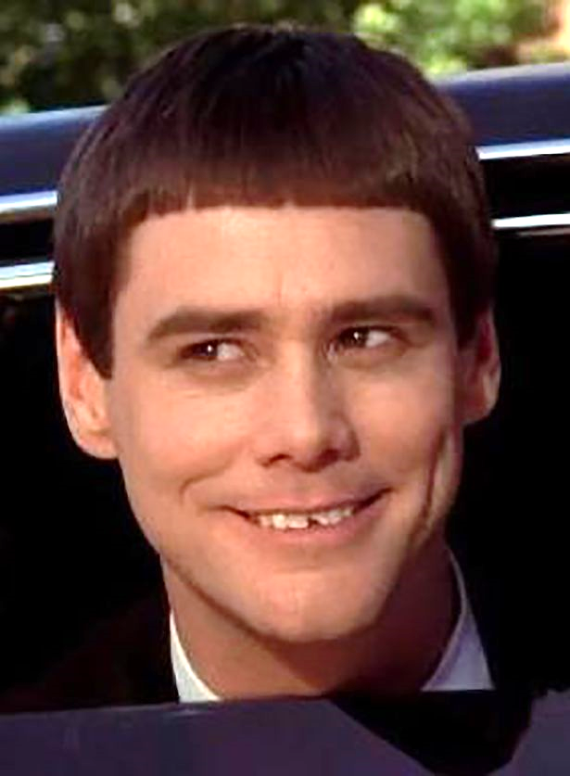
Expectation
Reality

Slide 4
Expectation
Reality

Slide 5
Expectation
Reality

Slide 6
Expectation
Reality

